Slide 1
ASP.Net Core –Service Configuration with Dependency Injection
Kamal Beydoun
Lebanese University – Faculty of Sciences I
Kamal.beydoun@ul.edu.lb

Slide 2
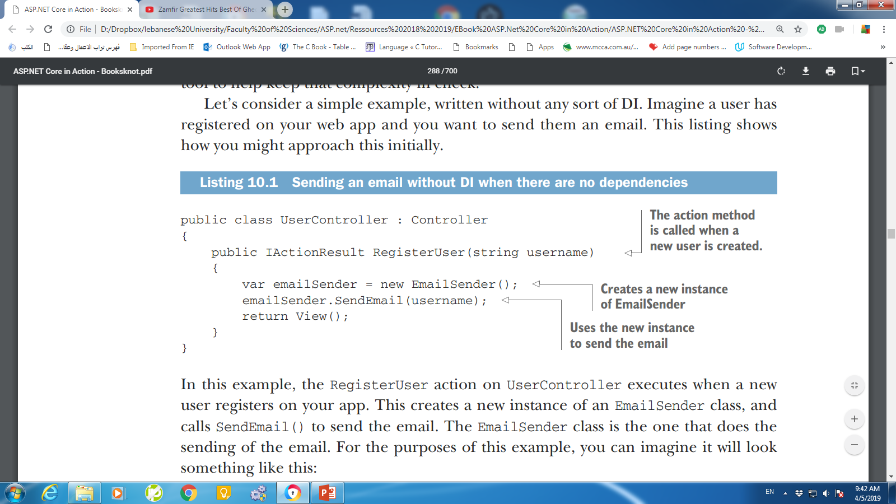
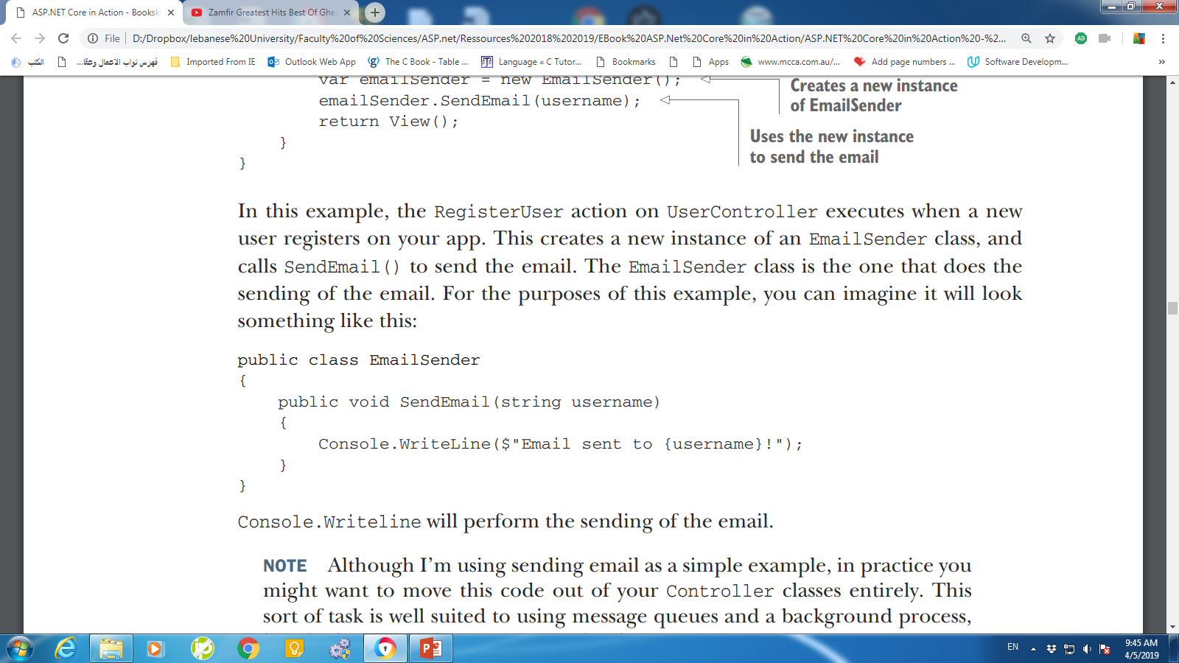
Understanding the benefits of dependency injection
But what if you later update your implementation of EmailSender so that it doesn’t implement the whole email-sending logic itself?
Notes:
ASP.NET Core has dependency injection baked in to the heart of the framework.

Slide 3
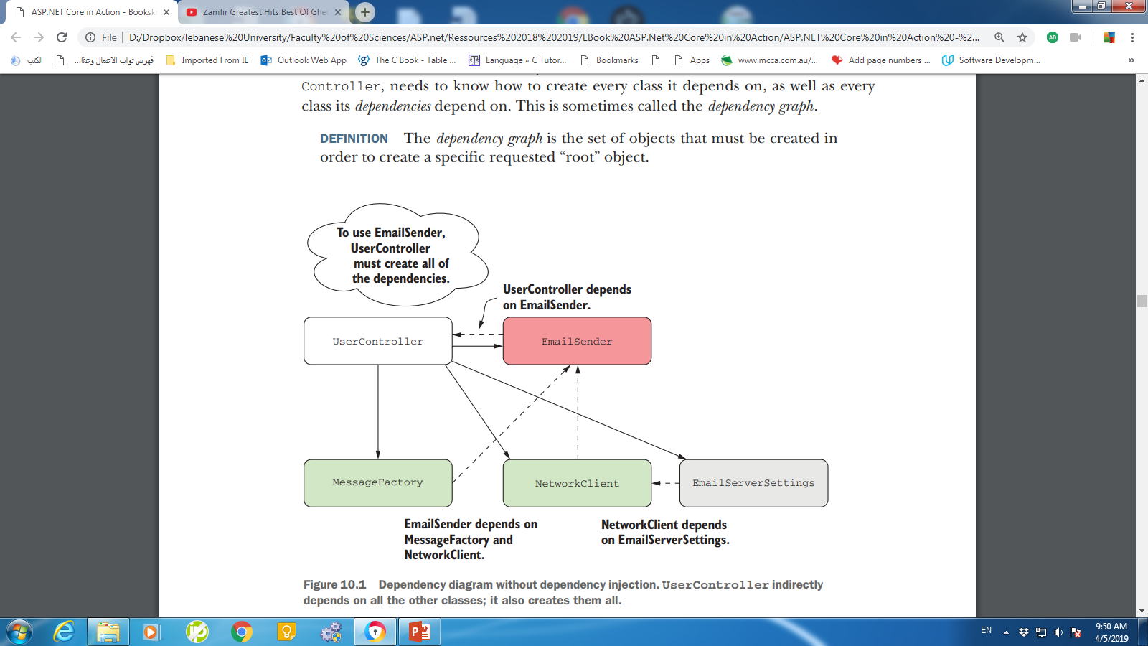
Understanding the benefits of dependency injection
Each class has a number of dependencies, so the “root” class, in this case UserController, needs to know how to create every class it depends on, as well as every class its dependencies depend on.
This is sometimes called the dependency graph.
Notes:
In practice, EmailSender would need to do a number of things to send an email. It would need to
○ Create an email message
○ Configure the settings of the email server
○ Send the email to the email server
The dependency graph is the set of objects that must be created in order to create a specific requested “root” object.

Slide 4
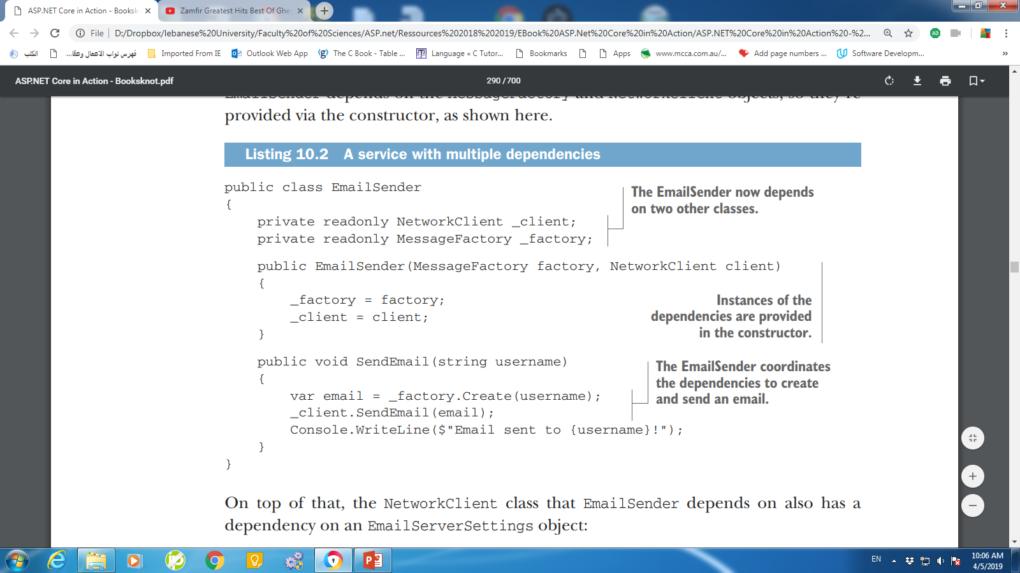
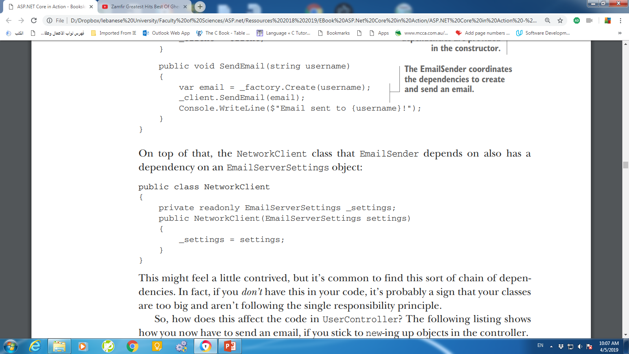
Understanding the benefits of dependency injection

Slide 5
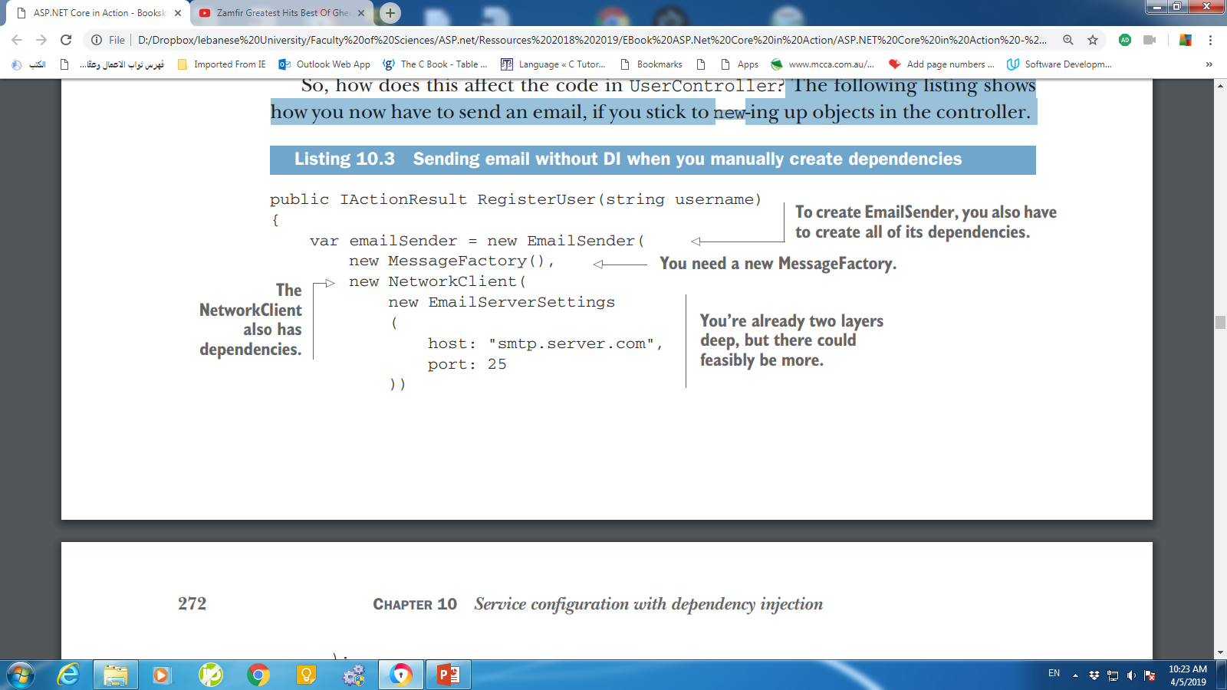
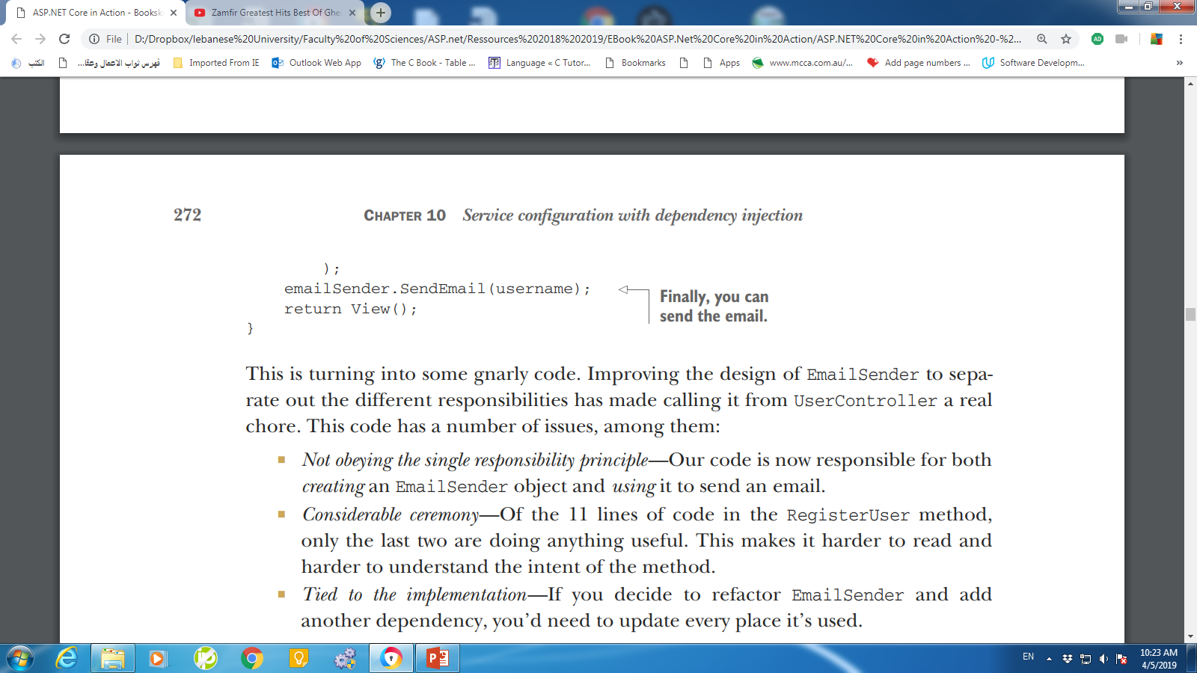
Understanding the benefits of dependency injection
how you now have to send an email, if you stick to new-ing up objects in the controller.
Notes:
The following listing shows how you now have to send an email, if you stick to new-ing up objects in the controller.

Slide 6
Issues of the code
Not obeying the single responsibility principle—Our code is now responsible for both creating an EmailSender object and using it to send an email.
Considerable ceremony— Of the 11 lines of code in the RegisterUser method, only the last two are doing anything useful.
This makes it harder to read and harder to understand the intent of the method.
Tied to the implementation—If you decide to refactor EmailSender and add another dependency, you’d need to update every place it’s used.

Slide 7
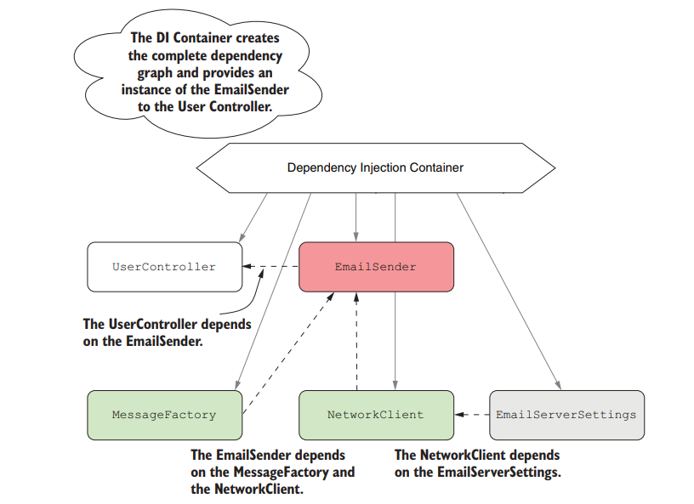
DI container or IoC container
Responsible for creating instances of services.
It knows how to construct an instance of a service by creating all of its dependencies and passing these to the constructor.
Notes:
IoC: Inversion of Control
UserController has an implicit dependency on the EmailSender class, as it manually creates the object itself as part of the RegisterUser method.
The only way to know that UserController uses EmailSender is to look at its source code.
In contrast, EmailSender has explicit dependencies on NetworkClient and MessageFactory, which must be provided in the constructor.
Similarly, NetworkClient has an explicit dependency on the EmailServerSettings class.

Slide 8
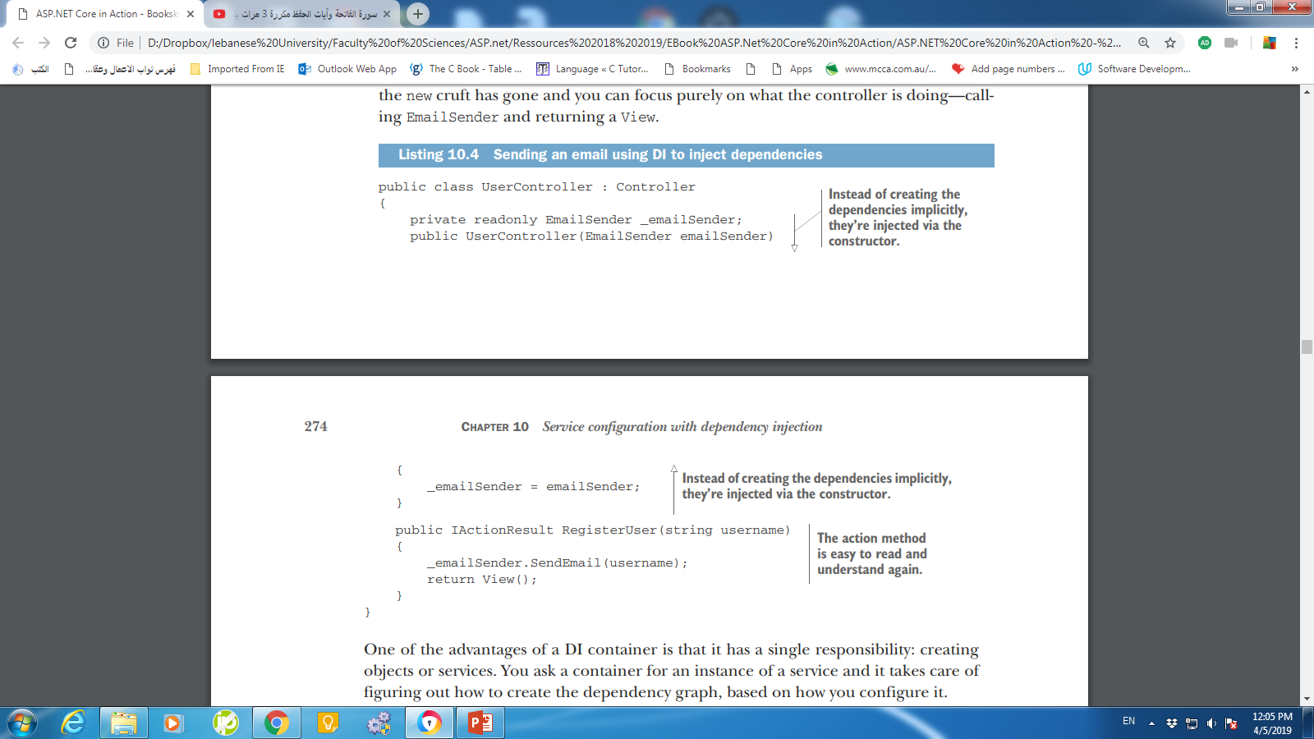
Dependency Injection Example
Any attempts to test UserController would result in an email being sent.
Notes:
The initial example of UserController and EmailSender was an example of tight coupling; you were creating the EmailSender object directly and needed to know exactly how to wire it up. On top of that, the code was difficult to test.
Any attempts to test UserController would result in an email being sent. If you were testing the controller with a suite of unit tests, that seems like a surefire way to get your email server blacklisted for spam!
Taking EmailSender as a constructor parameter and removing the responsibility of creating the object helps reduce the coupling in the system. If the EmailSender implementation changes so that it has another dependency, you no longer have to update UserController at the same time.
It’s common to refer to services when talking about DI containers, which is slightly unfortunate as it’s one of the most overloaded terms in software engineering! In this context, a service refers to any class or interface that the DI container creates when required.
You can inject dependencies into a service in other ways; for example, by using property injection. But constructor injection is the most common and is the only one supported out of the box in ASP.NET Core, so I’ll only be using that in this book.

Slide 9
Creating loosely coupled code
Coupling refers to how a given class depends on other classes to perform its function.
UserController is still tied to an implementation rather than an interface.
Coding to interfaces is a common design pattern that helps further reduce the coupling of a system, as you’re not tied to a single implementation.
This is particularly useful in making classes testable
Notes:
Taking EmailSender as a constructor parameter and removing the responsibility of creating the object helps reduce the coupling in the system. If the EmailSender implementation changes so that it has another dependency, you no longer have to update UserController at the same time.

Slide 10
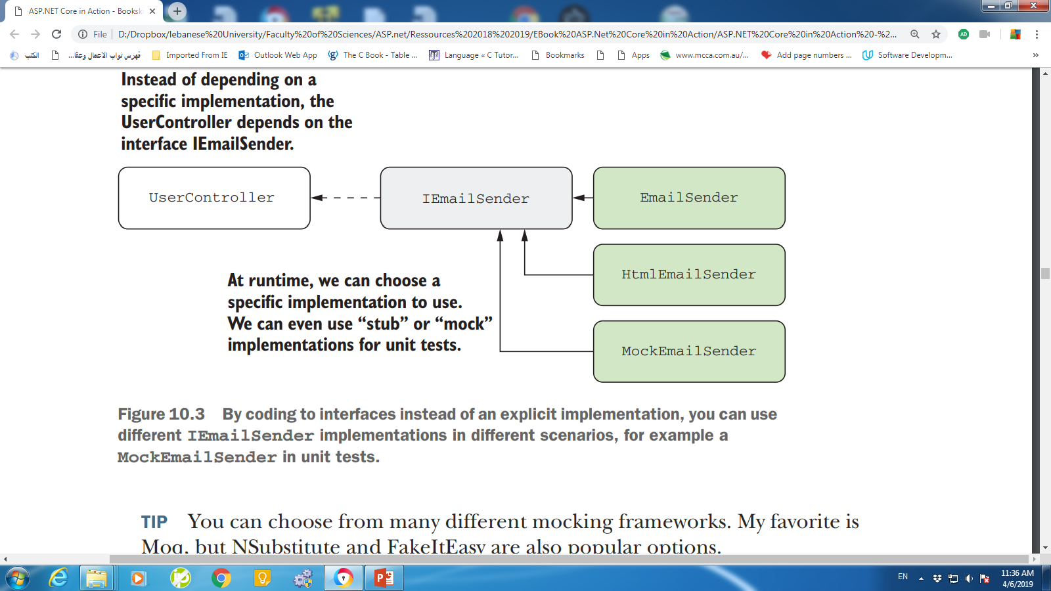
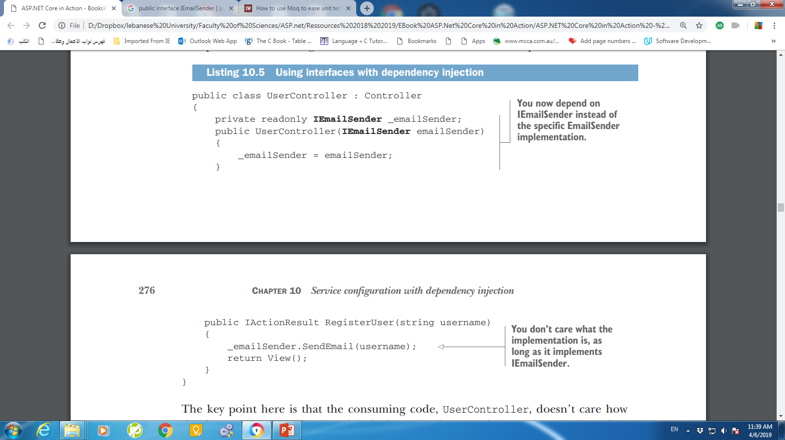
Creating loosely coupled code
public interface IEmailSender
{
public void SendEmail(string username);
}
That would allow you to use a different implementation during unit tests, a DummyEmailSender for example.

Slide 11
Service Registration
You register services with a DI container so that it knows which implementation to use for each requested service.
This typically takes the form of, “for interface X, use implementation Y.”

Slide 12
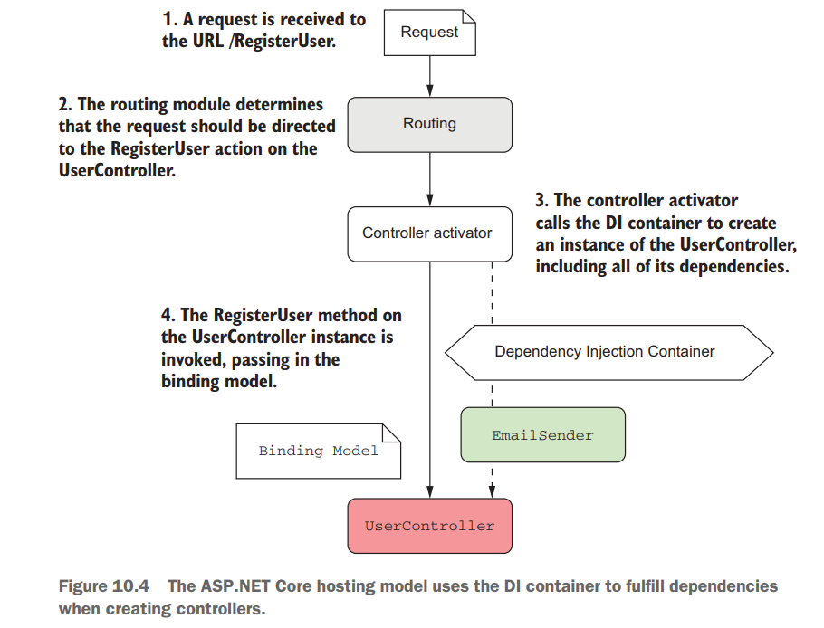
Dependency injection in ASP.NET Core
ASP.NET Core includes a simple DI container that all the framework libraries use to register themselves and their dependencies.
The DI container is built into the ASP.NET Core hosting model.
pulls dependencies from the DI container when they’re needed.
Notes:
The hosting model pulls dependencies from the DI container when they’re needed. If the framework determines that UserController is required due to the
incoming URL/route, the controller activator responsible for creating a Controller instance will ask the DI container for an IEmailSender implementation.
include your dependencies as constructor arguments directly and let the DI container provide them for you

Slide 13
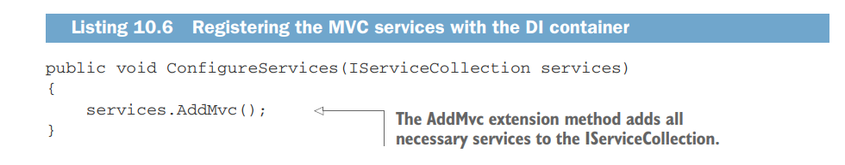
Adding ASP.NET Core framework services to the container
The dependency injection container is set up in the ConfigureServices method of your Startup class in Startup.cs.
By convention, each library that has necessary services should expose an Add*( ) extension method that you can call in ConfigureServices.

Slide 14
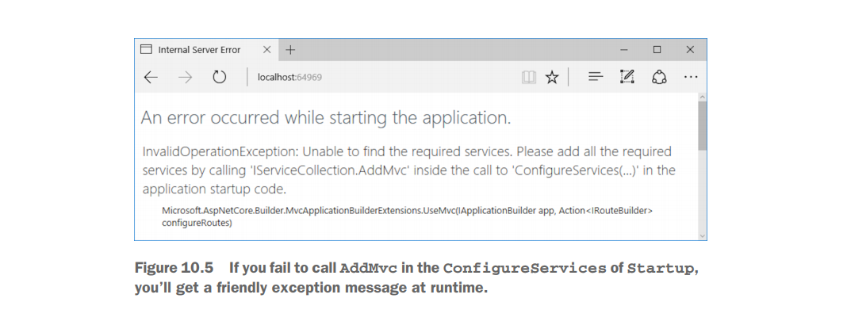
If Service Not added

Slide 15
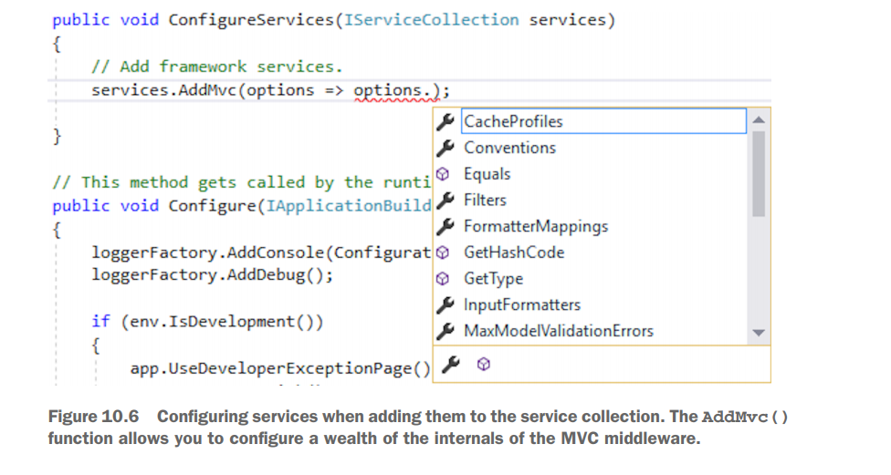
Services Options
Some of the Add*( ) extension methods allow you to specify additional options when you call them, often by way of a lambda expression.

Slide 16
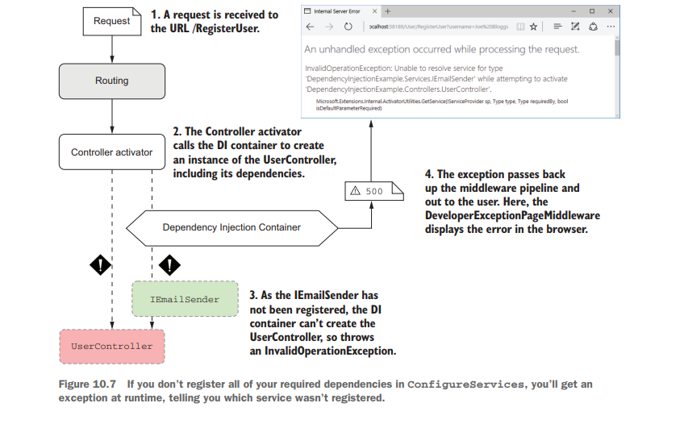
Exception if Service not registered

Slide 17
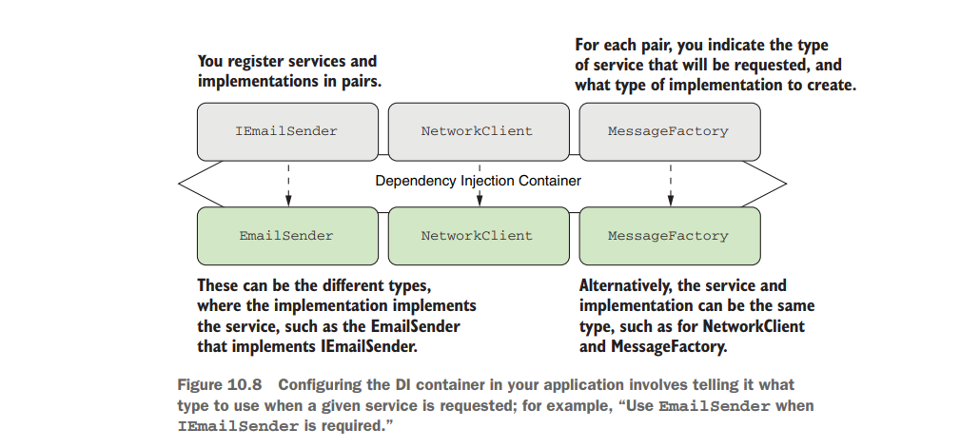
Registering your own services with the container
Notes:
In the first section of this chapter, I described a system for sending emails when a new user registers on your application. Initially, UserController was manually creating an instance of EmailSender, but you subsequently refactored this, so you inject an instance of IEmailSender into the constructor instead.
Configuring DI consists of making a series of statements about the services in your app. For example:
○ When a service requires IEmailSender, use an instance of EmailSender
○ When a service requires NetworkClient, use an instance of NetworkClient
○ When a service requires MessageFactory, use an instance of MessageFactory

Slide 18
Information provided by the registration methods
Service type—TService. What class or interface will be requested as a dependency.
Often an interface, such as IEmailSender, but sometimes a concrete type, such as NetworkClient or MessageFactory.
Implementation type—TService or TImplementation. The class the container should create to fulfill the dependency.
Must be a concrete type, such as EmailSender. May be the same as the service type, as for NetworkClient and MessageFactory.
Lifetime—Transient, Singleton, or Scoped. How long an instance of the service should be used for.

Slide 19
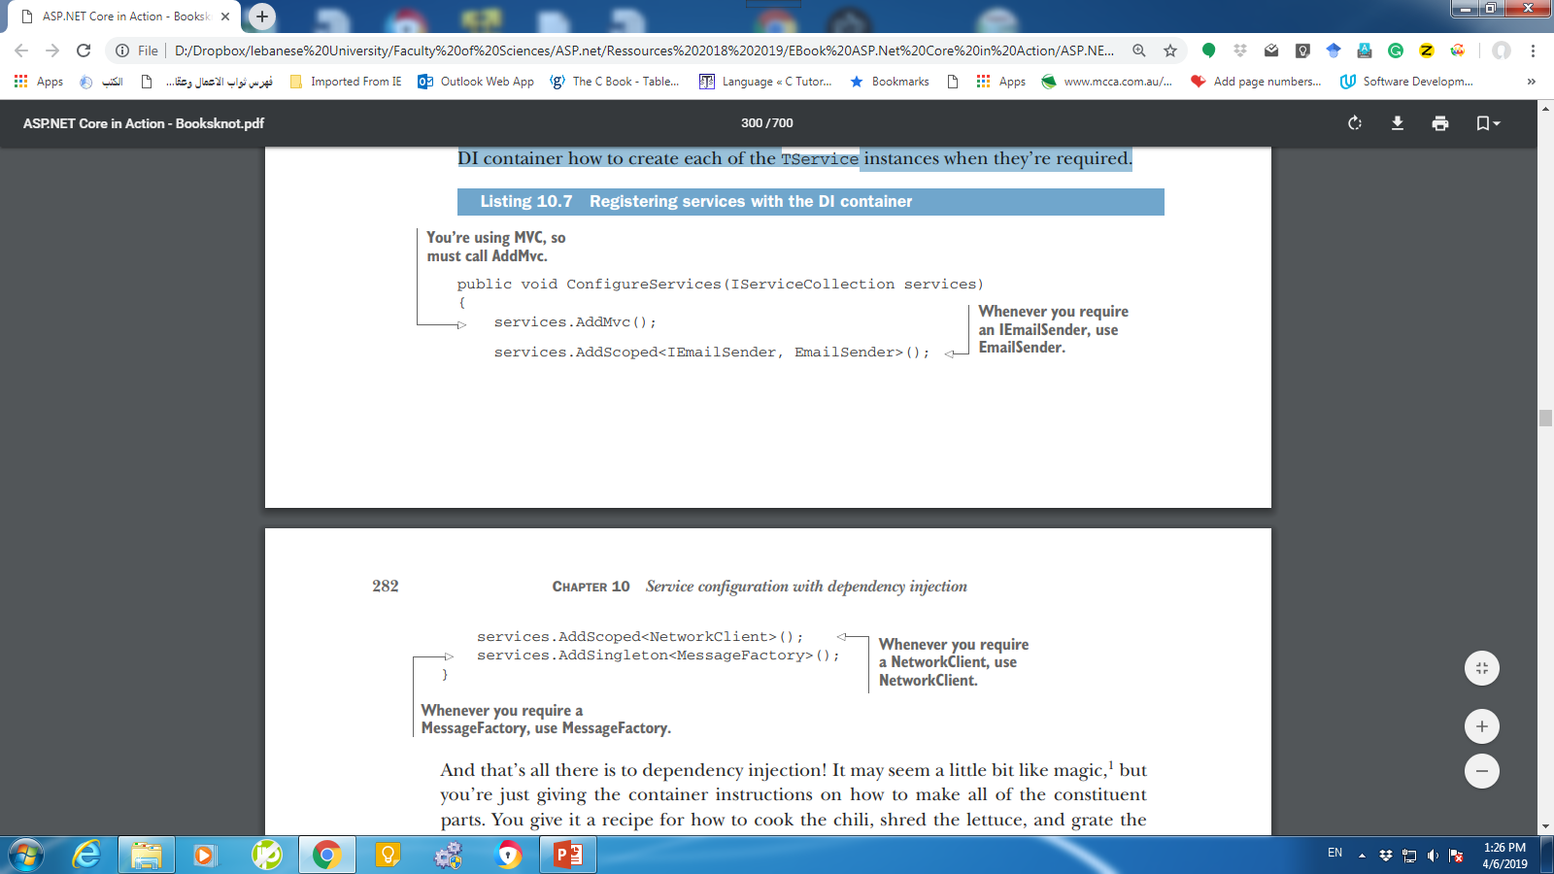
Example
Notes:
The following listing shows how you can configure EmailSender and its dependencies in your application using three different methods: AddScoped<TService>, AddSingleton<TService>, and AddScoped<TService, TImplementation>. This tells the DI container how to create each of the TService instances when they’re required.

Slide 20
Registering Services Assumptions
The preceding Add* methods use generics to specify the Type of the class to register.
They don’t give any indication of how to construct an instance of that type.
Instead, the container makes a number of assumptions that you have to adhere to:
The class must be a concrete type.
The class must have only a single “valid” constructor that the container can use.
For a constructor to be “valid,” all constructor arguments must be registered with the container, or must be an argument with a default value.

Slide 21
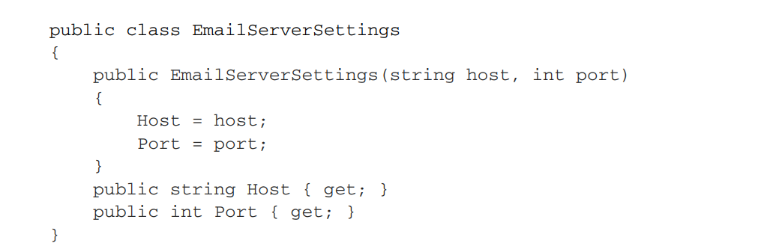
Registering services using objects
NetworkClient depends on EmailServerSettings.
The EmailServerSettings class doesn’t meet the requirements, as it requires you to provide a host and port in the constructor, which are strings without default values.

Slide 22
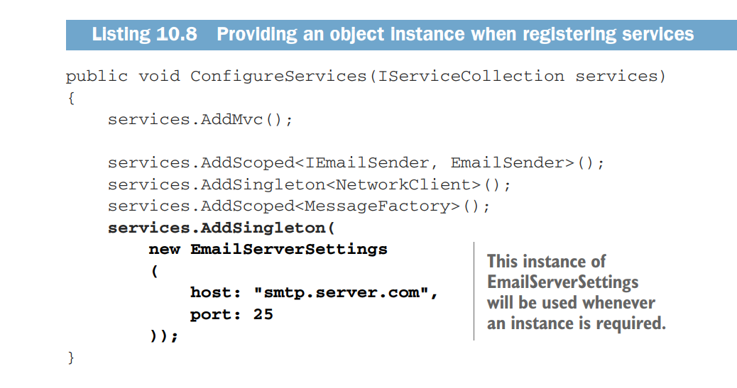
Registering services using objects
This works fine if you only want to have a single instance of EmailServerSettings in your application—the same object will be shared everywhere.
Notes:
You can’t register these primitive types in the container; it would be weird to say, “For every string constructor argument, in any type, use the "smtp.server.com" value!”
Instead, you can create an instance of the EmailServerSettings object yourself and provide that to the container, as shown next. The container will use the constructed object whenever an instance of the EmailServerSettings object is required.

Slide 23
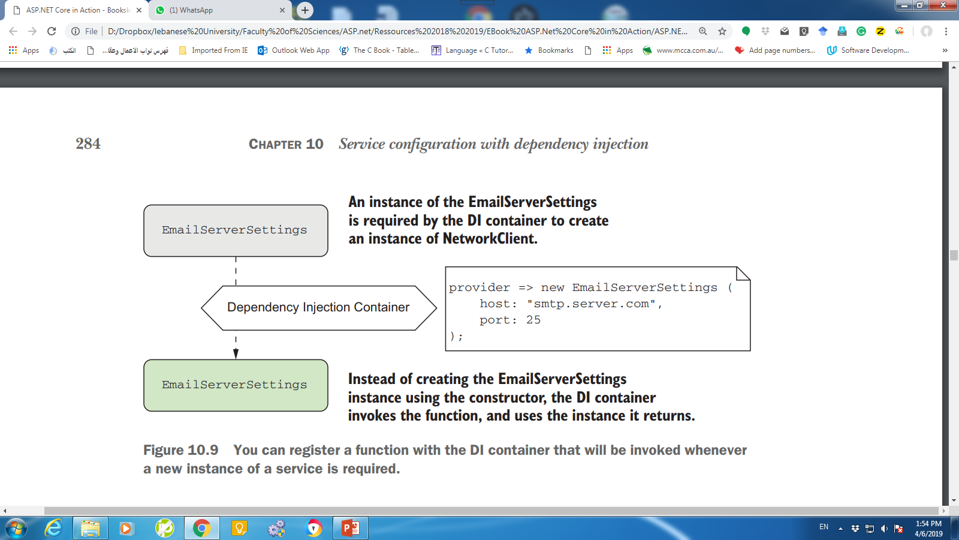
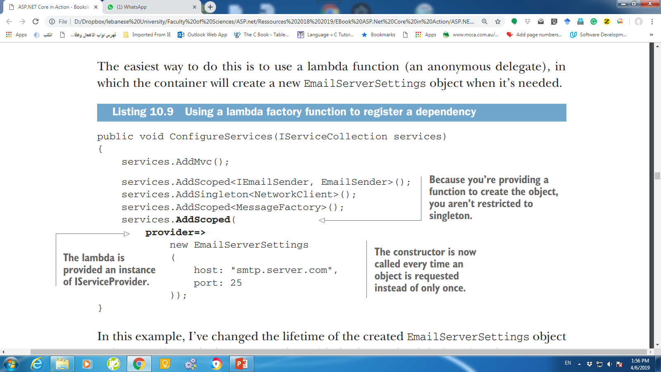
Registering services using objects and lambdas
Notes:
Instead of providing a single instance that the container will always use, you can also provide a function that the container will invoke when it needs an instance of the type,
In this example, I’ve changed the lifetime of the created EmailServerSettings object to be scoped instead of singleton and provided a factory lambda function that returns a new EmailServerSettings object. Every time the container requires a new EmailServerSettings, it executes the function and uses the new object it returns.

Slide 24
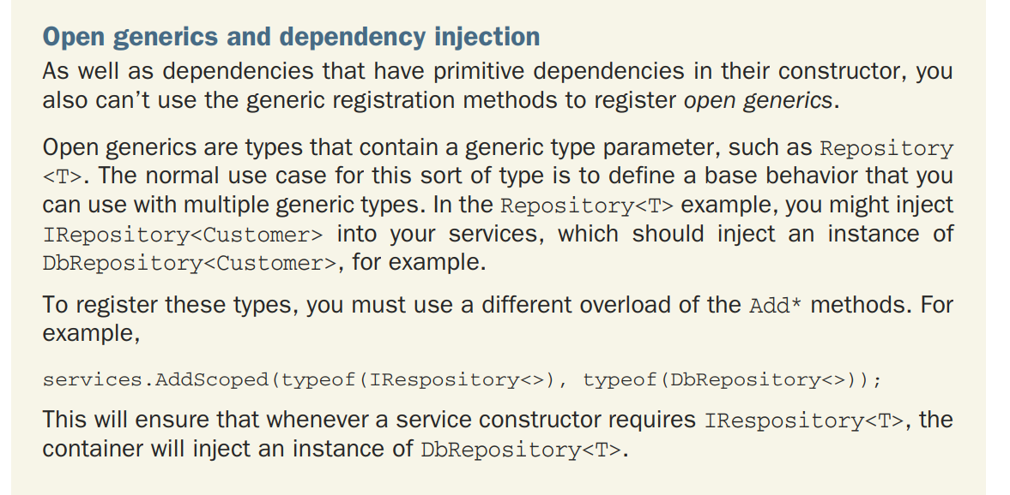
Generic Types

Slide 25
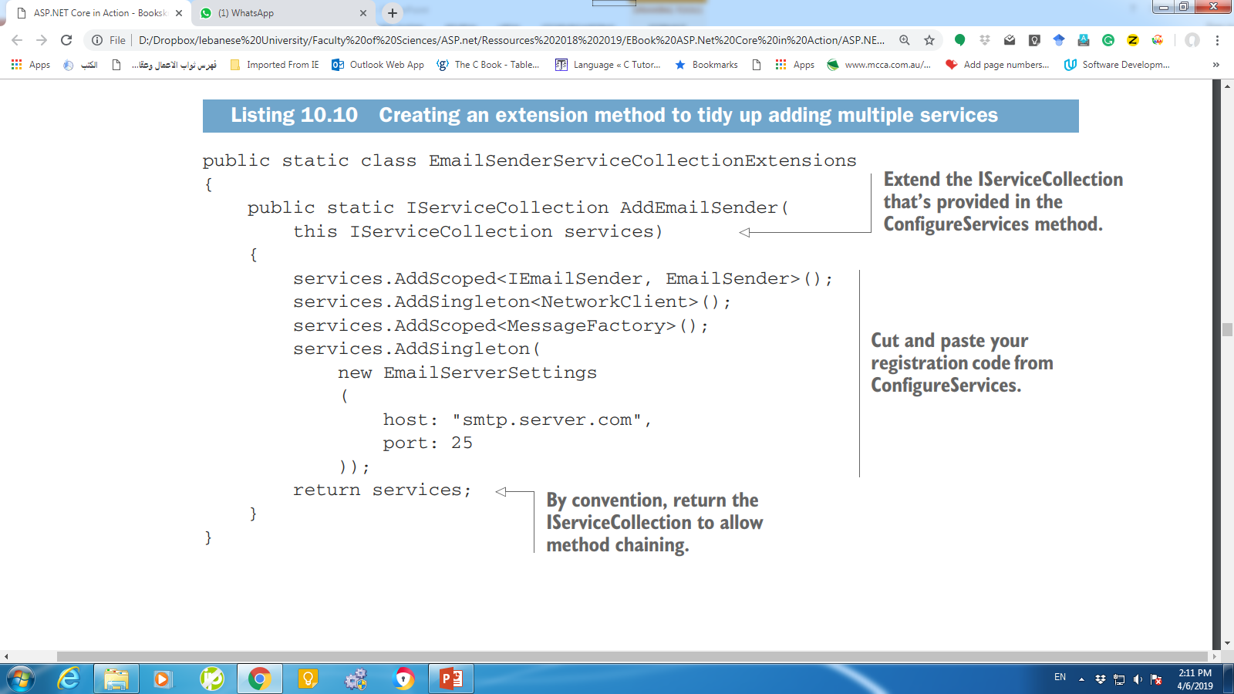
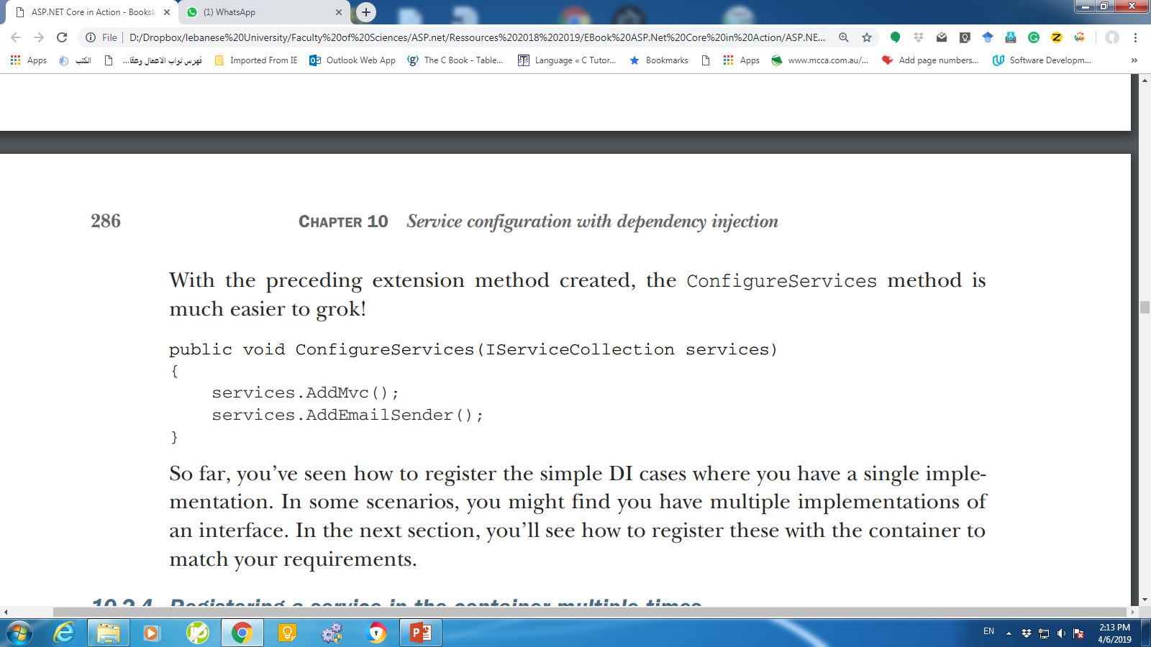
Extension Method

Slide 26
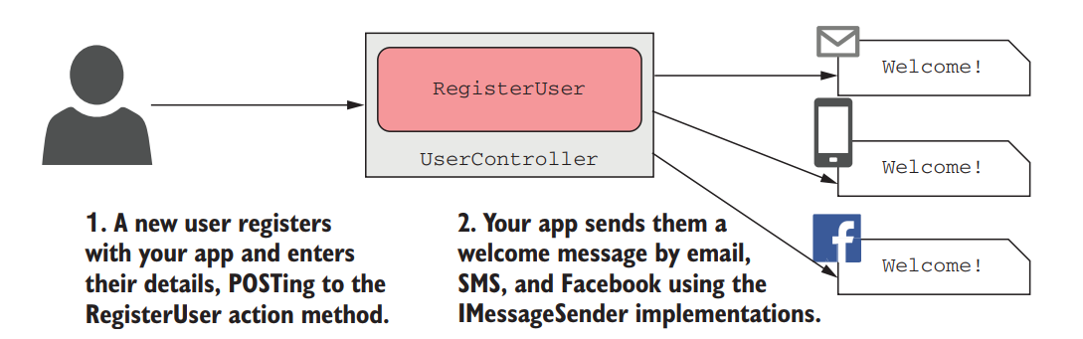
Registering a service in the container multiple times

Slide 27
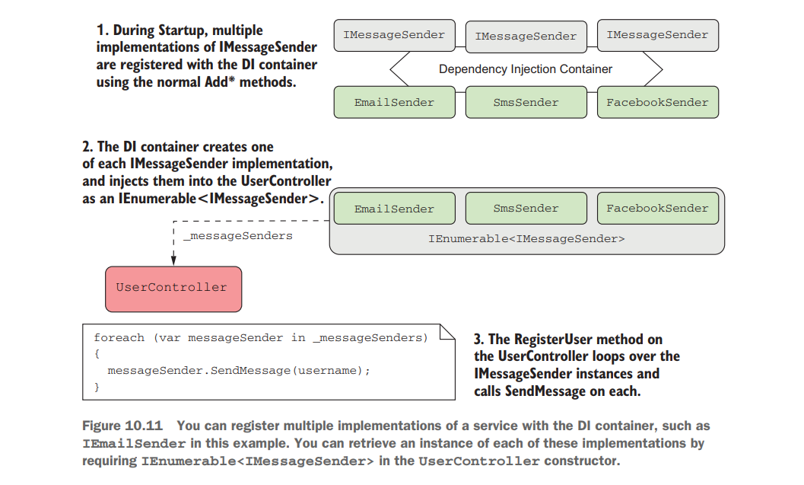
Registering a service in the container multiple times

Slide 28
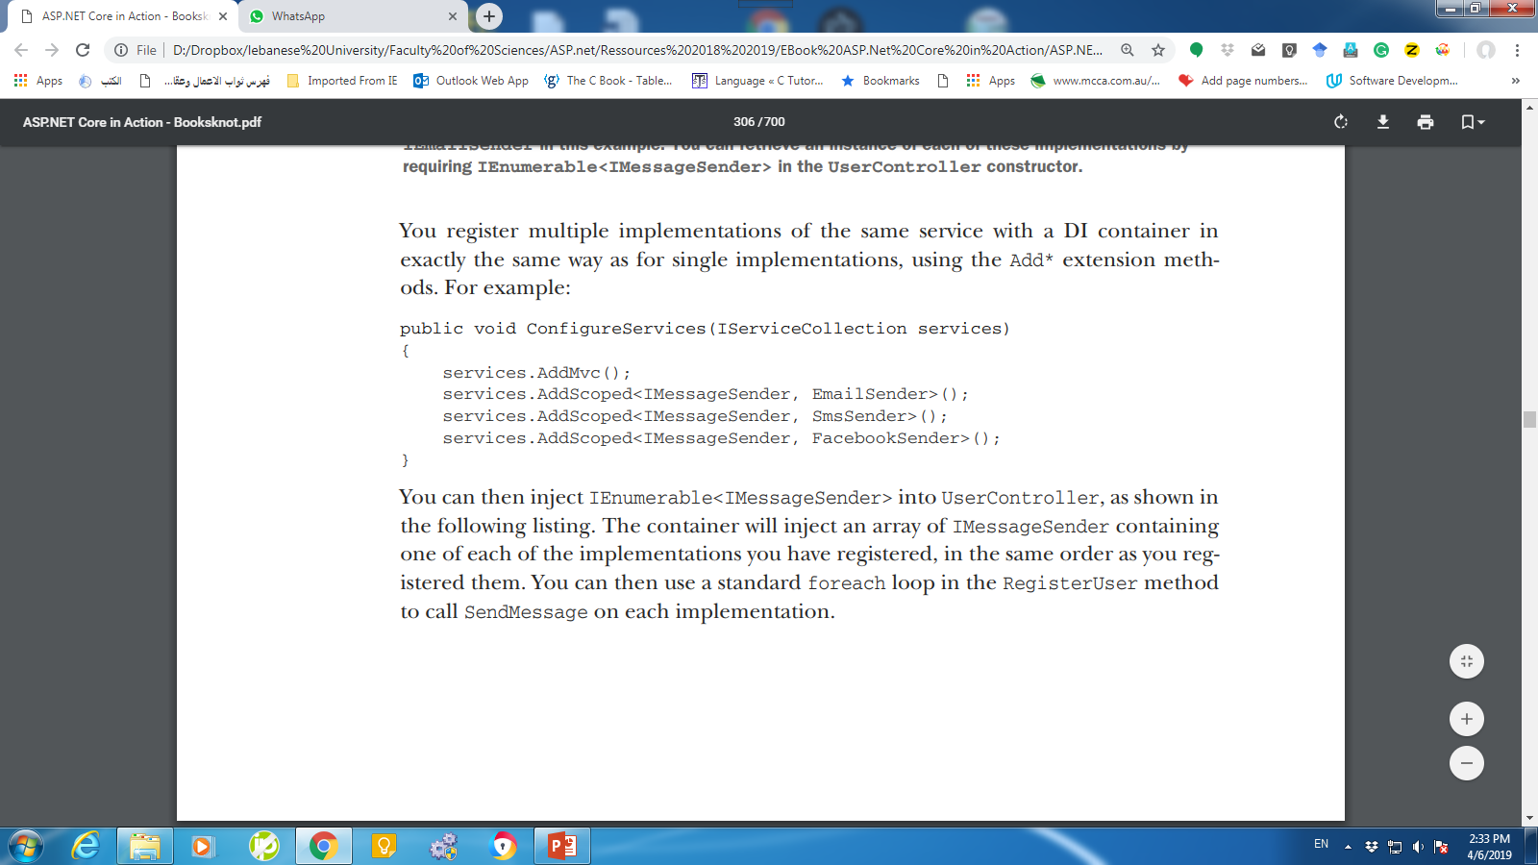
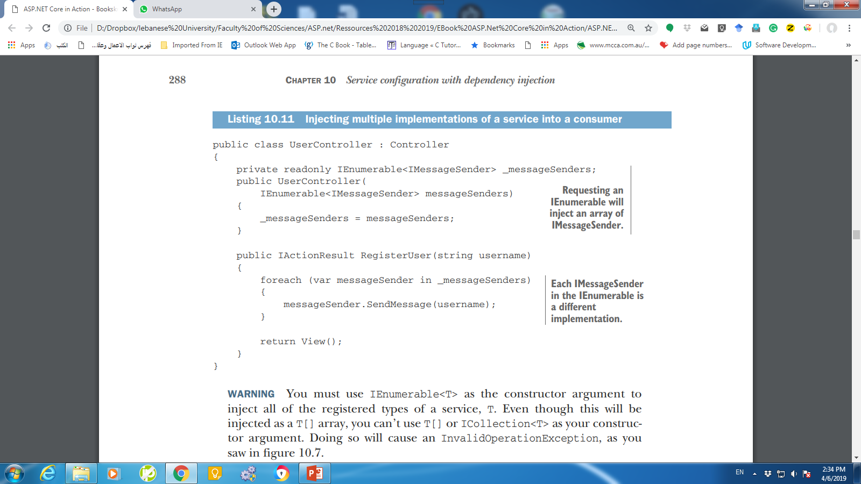
Registering a service in the container multiple times

Slide 29
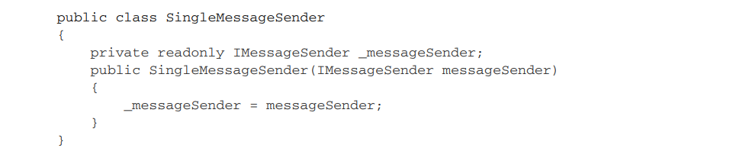
Injecting A Single Implementation When Multiple Services are Registered
Imagine you’ve already registered all of the IMessageSender implementations, what happens if you have a service that requires only one of them?
The DI container will use the last registered implementation of a service when resolving a single instance of the service.

Slide 30
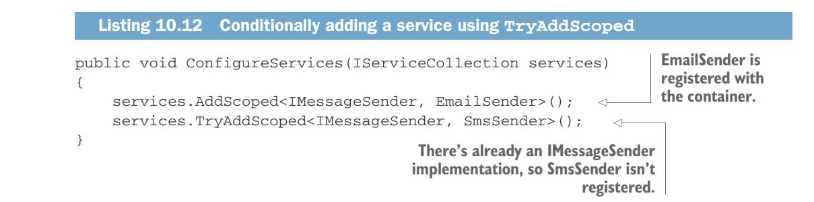
Conditionally Registering Services Using TryAdd
Code like this often doesn’t make a lot of sense at the application level, but it can be useful if you’re building libraries for use in multiple apps.

Slide 31
Injecting Services Directly into Action Methods Using [FromServices]
With constructor injection, dependencies are provided via the constructor.
DI container must create all of the services for every action method in a controller, even if none of them are required by the action method being called.
Notes:
I mentioned in section 10.1 that the ASP.NET Core DI container only supports constructor injection, but there are two additional locations where you can use dependency injection:
1 Action methods
2 View templates
------------
As you add additional action methods to a controller, you may find the controller needs additional services to implement new action methods. With constructor injection, all of these dependencies are provided via the constructor. That means the DI container must create all of the services for every action method in a controller, even if none of them are required by the action method being called.

Slide 32
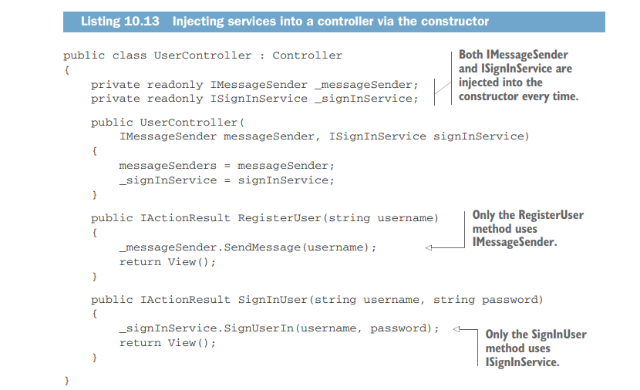
Injecting Services Directly into Action Methods Using [FromServices]
Notes:
Each action method requires a different dependency, so both dependencies will be created and injected, whichever action method is called by the request. If ISignInManager or IMessageSender have lots of dependencies themselves, the DI container may have to create lots of objects for a service that is often not used.
You can directly inject a dependency into an action method by passing it as a parameter to the method and using the [FromServices] attribute. During model binding, MvcMiddleware will resolve the parameter from the DI container, instead of from the request values, like you saw in chapter 6. This listing shows how you could rewrite listing 10.13 to use [FromServices] instead of constructor injection.

Slide 33
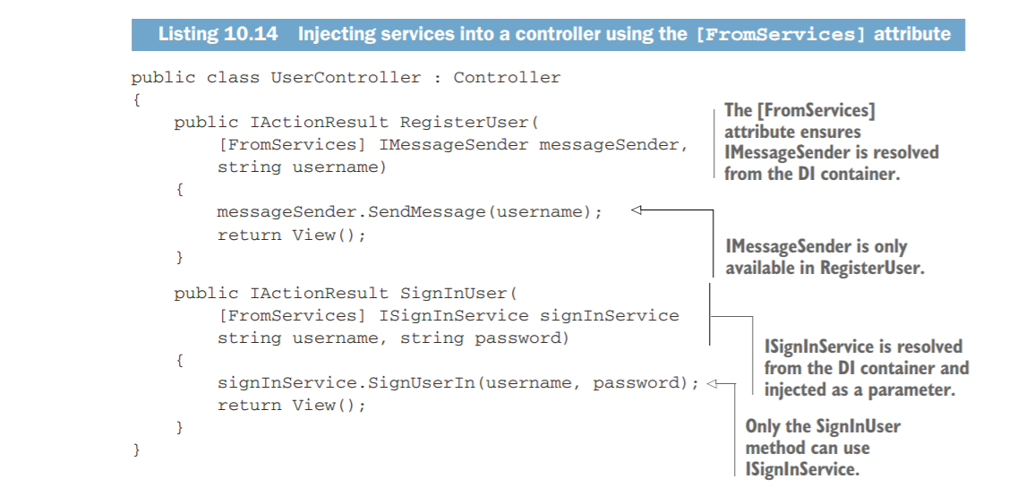
Injecting Services Directly into Action Methods Using [FromServices]
Notes:
You can directly inject a dependency into an action method by passing it as a parameter to the method and using the [FromServices] attribute. During model binding, MvcMiddleware will resolve the parameter from the DI container, instead of from the request values, like you saw in chapter 6. This listing shows how you could rewrite listing 10.13 to use [FromServices] instead of constructor injection.
You might be tempted to use the [FromServices] attribute in all of your action methods, but I’d encourage you to use standard constructor injection most of the time. Having the constructor as a single location that declares all the dependencies of a class can be useful, so I only use [FromServices] where creating an instance of a dependency is expensive and is only used in a single action method.

Slide 34
Understanding lifetimes: when are services created?
The lifetime of a service is how long an instance of a service should live in a container before it creates a new instance.
Three different lifetimes when registering a service with the built-in container:
Transient—Every single time a service is requested, a new instance is created.
This means you can potentially have different instances of the same class within the same dependency graph.
Scoped—Within a scope, all requests for a service will give you the same object.
For different scopes you’ll get different objects. In ASP.NET Core, each web request gets its own scope.
Singleton—You’ll always get the same instance of the service, no matter which scope.

Slide 35
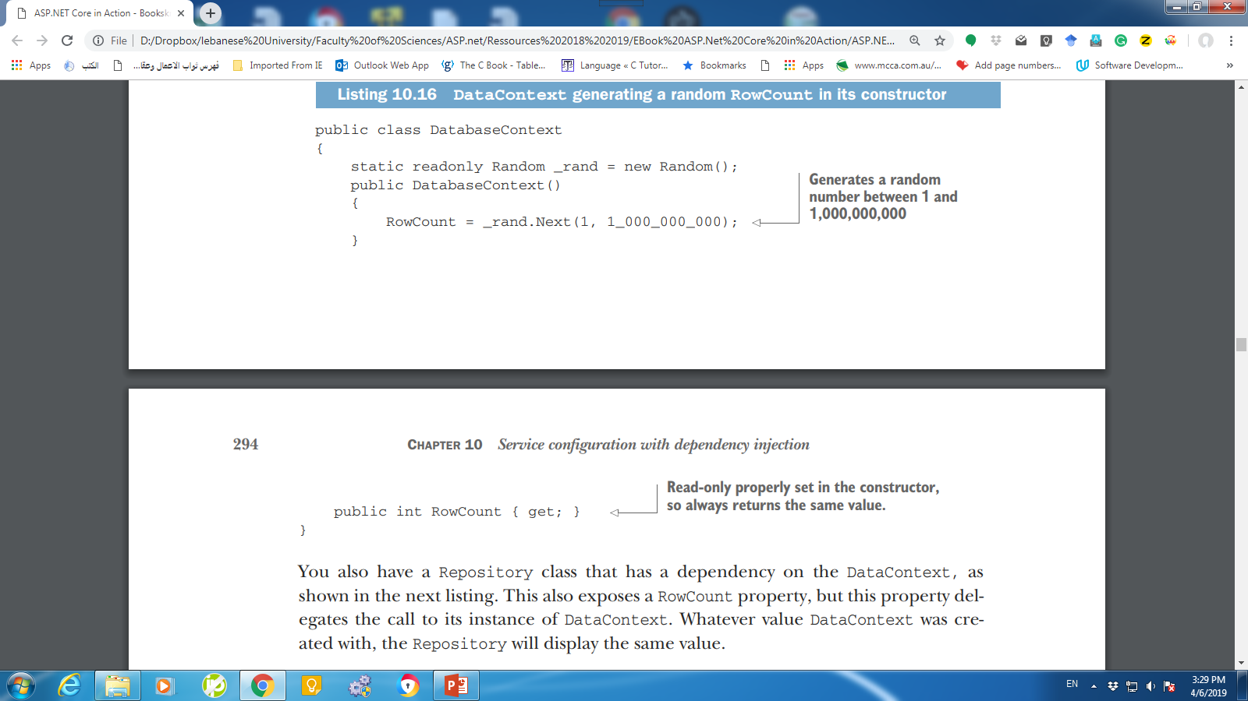
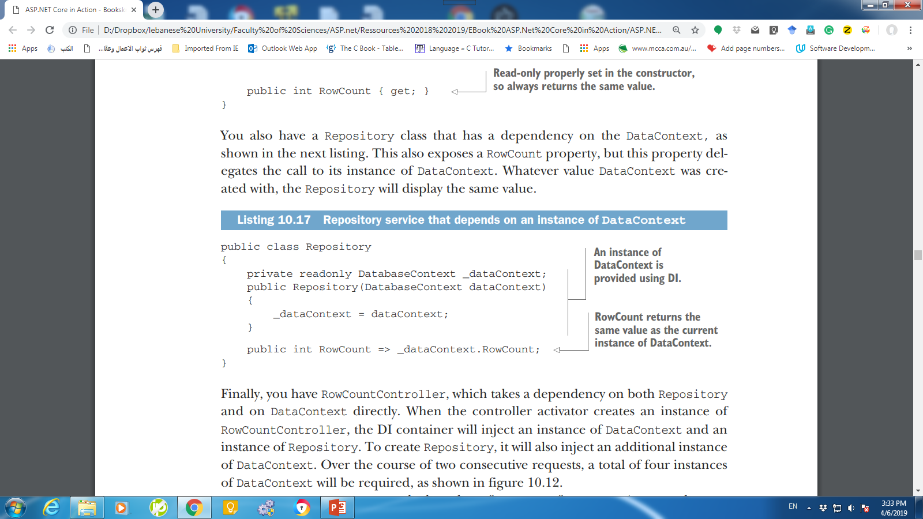
Example
Notes:
I’ll use a simple representative example. Imagine you have DataContext, which has a connection to a database as shown in listing 10.13. It has a single property, RowCount, which displays the number of rows in the Users table of a database.

Slide 36
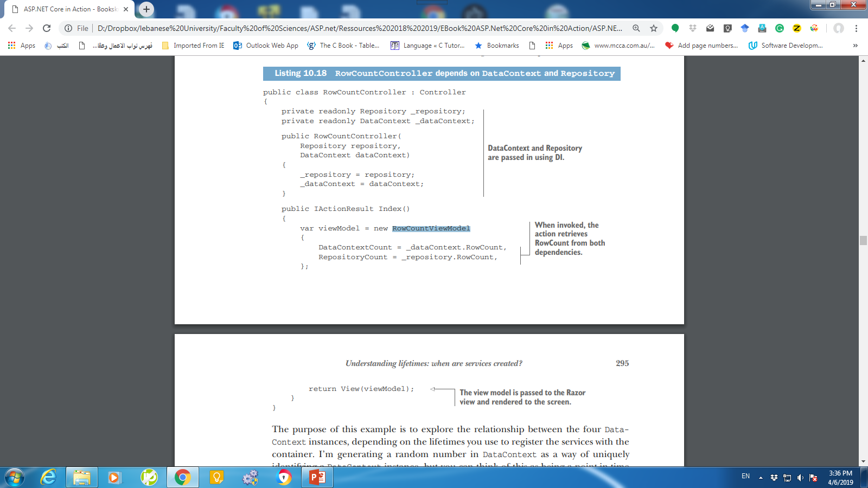
Example

Slide 37
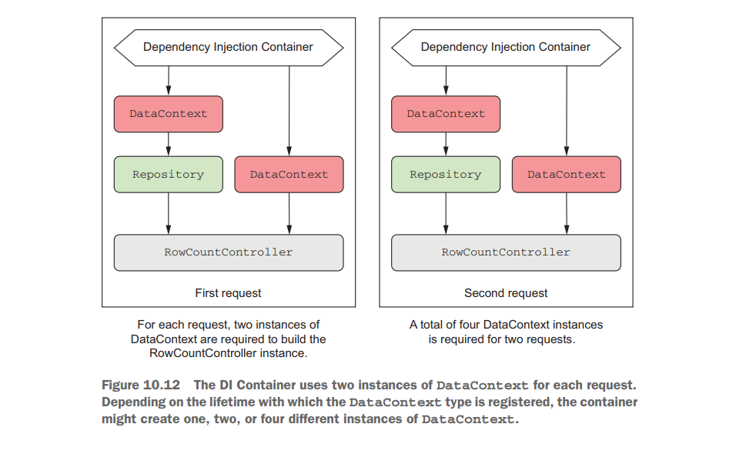
Example

Slide 38
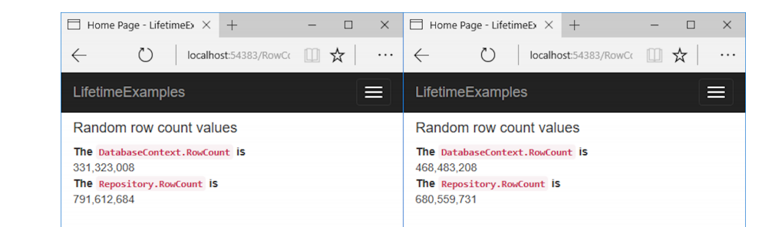
Transient: everyone is unique
Every time a dependency is required, the container will create a new one. This applies both between requests but also within requests; the DataContext injected into the Repository will be a different instance to the one injected into the RowCountController.
services.AddTransient<DataContext>();
services.AddTransient<Repository>();
Notes:
Transient lifetimes can result in a lot of objects being created, so they make the most sense for lightweight services with little or no state. It’s equivalent to calling new every
time you need a new object, so bear that in mind when using it. You probably won’t use the transient lifetime too often; the majority of your services will probably be
scoped instead.

Slide 39
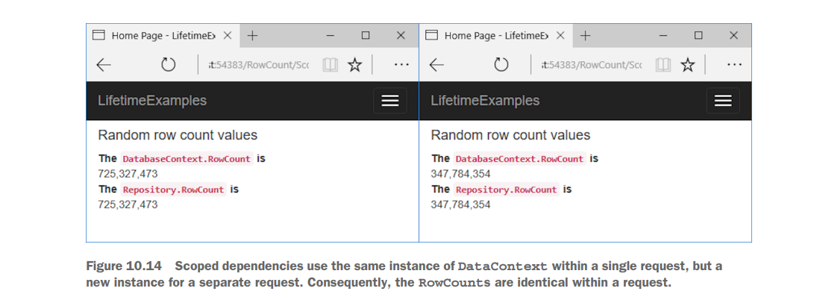
Scoped: let’s stick together, guys
services.AddScoped<DataContext>();
In ASP.NET Core, a scope maps to a request, so within a single request the container will use the same object to fulfill all dependencies.
Notes:
The scoped lifetime states that a single instance of an object will be used within a given scope, but a different instance will be used between different scopes. In ASP.NET Core, a scope maps to a request, so within a single request the container will use the same object to fulfill all dependencies.

Slide 40
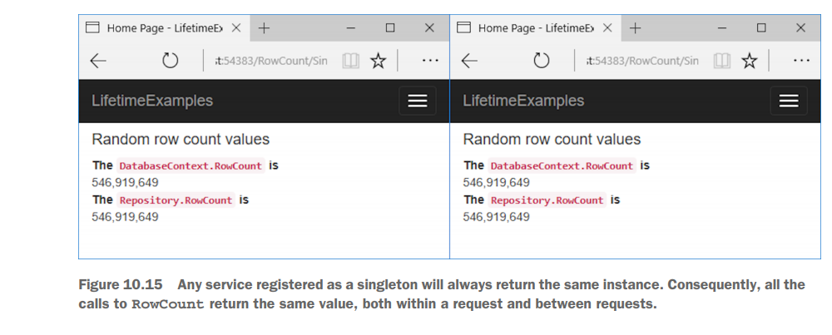
Singleton: there can be only one
services.AddSingleton<DataContext>();
Notes:
The singleton pattern is particularly useful for objects that are either expensive to create or that don’t hold state.
Singleton services must be thread safe in a web application, as they’ll typically be used by multiple threads during concurrent requests.
Singletons are convenient for objects that need to be shared or that are immutable and expensive to create. A caching service should be a singleton, as all requests need to share it.
Similarly, you might register a settings object loaded from a remote server as a singleton, if you loaded the settings once at startup and reused them through the lifetime of your app.

Slide 41
Keeping an eye out for captured dependencies
A service should only use dependencies with a lifetime longer than or equal to the lifetime of the service.
A service registered as a singleton can only use singleton dependencies.
A service registered as scoped can use scoped or singleton dependencies.
A transient service can use dependencies with any lifetime.

Slide 42
Summary
Dependency injection is baked into the ASP.NET Core framework. You need to ensure your application adds all the framework's dependencies in Startup.
The dependency graph is the set of objects that must be created in order to create a specific requested “root” object.
You should aim to use explicit dependencies over implicit dependencies in most cases. ASP.NET Core uses constructor arguments to declare explicit dependencies.
The DI or IoC container is responsible for creating instances of services. It knows how to construct an instance of a service by creating all of its dependencies and passing these to the constructor.
When discussing DI, the term service is used to describe any class or interface registered with the container.
You register services with a DI container so it knows which implementation to use for each requested service. This typically takes the form of, “for interface X, use implementation Y.”

Slide 43
Summary
The default built-in container only supports constructor injection. If you require other forms of DI, such as property injection, you can use a third-party container.
You can register services with the container by calling Add* extension methods on IServiceCollection in ConfigureServices in Startup.
If you forget to register a service that’s used by the framework or in your own code, you’ll get an InvalidOperationException at runtime.
When registering your services, you describe three things: the service type, the implementation type, and the lifetime. The service type defines which class or interface will be requested as a dependency. The implementation type is the class the container should create to fulfill the dependency. The lifetime is how long an instance of the service should be used for.
You can register a service using generic methods if the class is concrete and all its constructor arguments must be registered with the container or have default values.

Slide 44
Summary
You can provide an instance of a service during registration, which will register that instance as a singleton.
You can provide a lambda factory function that describes how to create an instance of a service with any lifetime you choose.
Avoid calling GetService() in your factory functions if possible. Instead, favor constructor injection—it’s more performant, as well as being simpler to reason about.
You can register multiple implementations for a service. You can then inject IEnumerable<T> to get access to all of the implementations at runtime.
If you inject a single instance of a multiple-registered service, the container injects the last implementation registered.
You can use the TryAdd* extension methods to ensure that an implementation is only registered if no other implementation of the service has been registered.

Slide 45
Summary
You define the lifetime of a service during DI service registration. This dictates when a DI container will reuse an existing instance of the service to fulfill service dependencies and when it will create a new one.
The transient lifetime means that every single time a service is requested, a new instance is created.
The scoped lifetime means that within a scope, all requests for a service will give you the same object. For different scopes, you’ll get different objects. In ASP.NET Core, each web request gets its own scope.
You’ll always get the same instance of a singleton service, no matter which scope.
A service should only use dependencies with a lifetime longer than or equal to the lifetime of the service.

